Slide 1
Azure Foundations

Slide 2
Topics
Enterprise Components Overview
Enterprise Roles
Primitives
Azure Authorization
Azure RBAC roles
Classic subscription admin roles
Azure Policy

Slide 3
Enterprise Components Overview
Enterprise Agreement
Contractual agreement with Microsoft that allows for purchase of software licenses, cloud services, and support
Enrollment
Describes the shape and use of Azure services your company will consume
Department
Optional entity that allows you to segment costs into logical groupings and set a budget or quota at the department level (budget not enforceable)
Account
Globally unique entity that gets you access to Azure services and subscriptions
Subscription
Logical container for Azure resources
Notes:
Resources
https://docs.microsoft.com/en-us/azure/cost-management-billing/manage/ea-portal-get-started

Slide 4
Enterprise Roles
Enterprise Administrator
Manage accounts and account owners
Manage other Enterprise Administrators and Department Administrators
View usage across all accounts and unbilled charges across all accounts
Can be granted read-only access
Department Administrator (Optional)
Create and manage departments
Create new account owners
View usage details for departments they manage and view costs if they have necessary permissions
Can be granted read-only access
Manage Notification contacts
View and manage all reservation orders and reservations that apply to EA
Notes:
When transferring account, target account me be valid Azure commerce account
Transferring subscriptions between tenants results in losing all Azure Policy assignments, RBAC assignments/definitions
Resources
https://docs.microsoft.com/en-us/azure/cost-management-billing/manage/understand-ea-roles#usage-and-costs-access-by-role

Slide 5
Enterprise Roles (Continued)
EA Purchaser
Notification Contact
Receive usage information related to enrollment
Purchase Azure services including reservations
View usage across all accounts
View and manage all reservations orders
Service principal only
Account Owner
Create and manage subscriptions
Manage Service Administrators
View usage for subscriptions

Slide 6
Enterprise Components/Roles – Design Recommendations
Use Azure AD authentication only (Work and School accounts) and avoid using Microsoft Live accounts.
For privileged roles use existing privileged access patterns. For example, using shared accounts where credentials are secured in a secret management system.
Grant business users (such as accounting and finance) read-only versions of Enterprise Admin and Department Admin.
Consider creating separate Azure Account for non-production and production to limit blast radius of compromise of an Account Owner.
Do not use the Azure AD / Microsoft identity associated with the email address set for the Azure Account when administering Microsoft Azure
Use separate identities for administration of the EA Portal, Azure, Azure AD, and Microsoft 365 services such as Exchange or Sharepoint

Slide 7
Primitives - Azure AD Tenant
Identity plane for Microsoft Cloud Services
Identity repository for human and non-human identities
Multifactor Authentication
Conditional Access
Critical blast radius

Slide 8
Primitives - Azure AD Tenant Design Recommendations
Limit the number of Azure AD tenants to as few as possible to limit operational overhead.
Use a single Azure AD tenant for all Azure workloads including production and non-production environments.
Use a separate Azure AD tenant only for testing Azure AD and Microsoft 365 features. All Azure workloads should exist under a single tenant if possible.
Create breakglass accounts for Azure AD to recover control in case of a security incident or outage of on-premises identity infrastructure.
Enable multi-factor authentication for all users that will be administering Azure resources.

Slide 9
Primitives - Azure AD Tenant Design Recommendations (continued)
At a minimum, use conditional access to enforce MFA and geolocation restrictions for users with access to Azure resources.
Ensure privileged roles such as Global Admins and User Administrators are granted on a per use and time bound basis through a privileged access management system such as Azure AD Privileged Identity Management, CyberArk, or Thycotic.
For Azure workloads use Managed Identities instead of Service Principals whenever possible.
Rotate credentials for Service Principals on a regular basis.

Slide 10
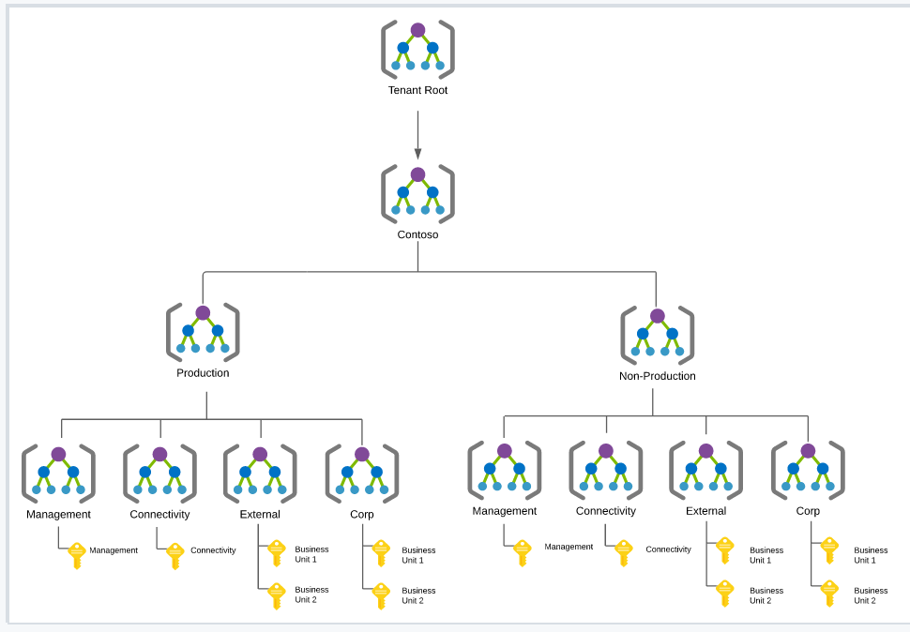
Primitives - Management Groups
Logical containers for subscriptions
Enforce authorization (Azure RBAC)
Enforce compliance (Azure Policy)

Slide 11
Primitives – Management Group Design Recommendations
Keep the management group hierarchy flat and limited to four levels.
Always start with a single organizational management group under the root management group.
Create a default management group for new subscriptions to ensure a minimum level of security can be applied to the subscriptions.
Tightly control access to management groups limiting it to a service principal if possible.

Slide 12
Primitives – Management Group Design Recommendations (continued)
Use management groups for Azure RBAC and Azure Policy inheritance whenever possible.
Avoid assigning Azure Policy and Azure RBAC at the tenant root management group.
Consider putting sandboxed workloads in a separate management group to allow for exploration of new Azure services.
Enable Azure RBAC for Management groups to limit who can create management groups.
Enable diagnostic logging for management group Activity Logs.
Apply the Azure Security Benchmarks initiative in audit mode at the organizational top-level management group under the root management group.

Slide 13
Primitives - Subscriptions
Limits boundary
Authorization boundary (blast radius)
Compliance boundary (Azure Policy)
Blast radius
Cost boundary

Slide 14
Primitives – Subscriptions Design Recommendations
Subscriptions used by the organization for non-production and production should be created from an Enterprise Enrollment and should be associated to the production Azure AD tenant.
Work with your Microsoft support team to block subscriptions that are not sourced from the Enterprise Enrollment. This would include subscriptions offers like Visual Studio and Pay-As-You-Go subscriptions.
Subscriptions used by individual employees for the purposes of learning and experimentation should be Visual Studio Subscriptions and should not be associated to any of the organization's Azure AD tenants.

Slide 15
Primitives – Subscriptions Design Recommendations (continued)
Establish formalized process for the subscription lifecycle.
Separate subscriptions for shared infrastructure services from subscriptions containing resources for specific workloads.
Use separate subscriptions for non-production and production
Use separate subscriptions as boundaries between workloads with differing compliance requirements.
Avoid granting human users the Contributor or Owner role on a subscription. Consider using less-privileged built-in Azure RBAC roles or creating custom RBAC roles.
Monitor subscription resource limits using Azure Advisor.

Slide 16
Primitives – Resource Groups
Logical container for Azure resources
Authorization boundary
Compliance boundary (Azure Policy)

Slide 17
Primitives – Resource Group Design Recommendations
Group workload resources which will share the same lifecycle and control.
Use resource groups as an authorization boundary to minimize the blast radius between workloads in the same subscription.
Avoid assigning policies at the resource group layer due to the operational overhead incurred.

Slide 18
Azure Authorization
Azure Active Directory admin roles
Azure RBAC roles
Classic subscription admin roles
Azure account Admin

Slide 19
Azure Classic Subscription Admin Roles
Old authorization mechanism for Microsoft Azure.
Avoid using classic roles unless you have Azure classic (Azure Service Manager / ASM) workloads.
Be aware that Azure Account Owners are by default. made Service Administrators which are equivalent to the Azure RBAC Owner role over a subscription.

Slide 20
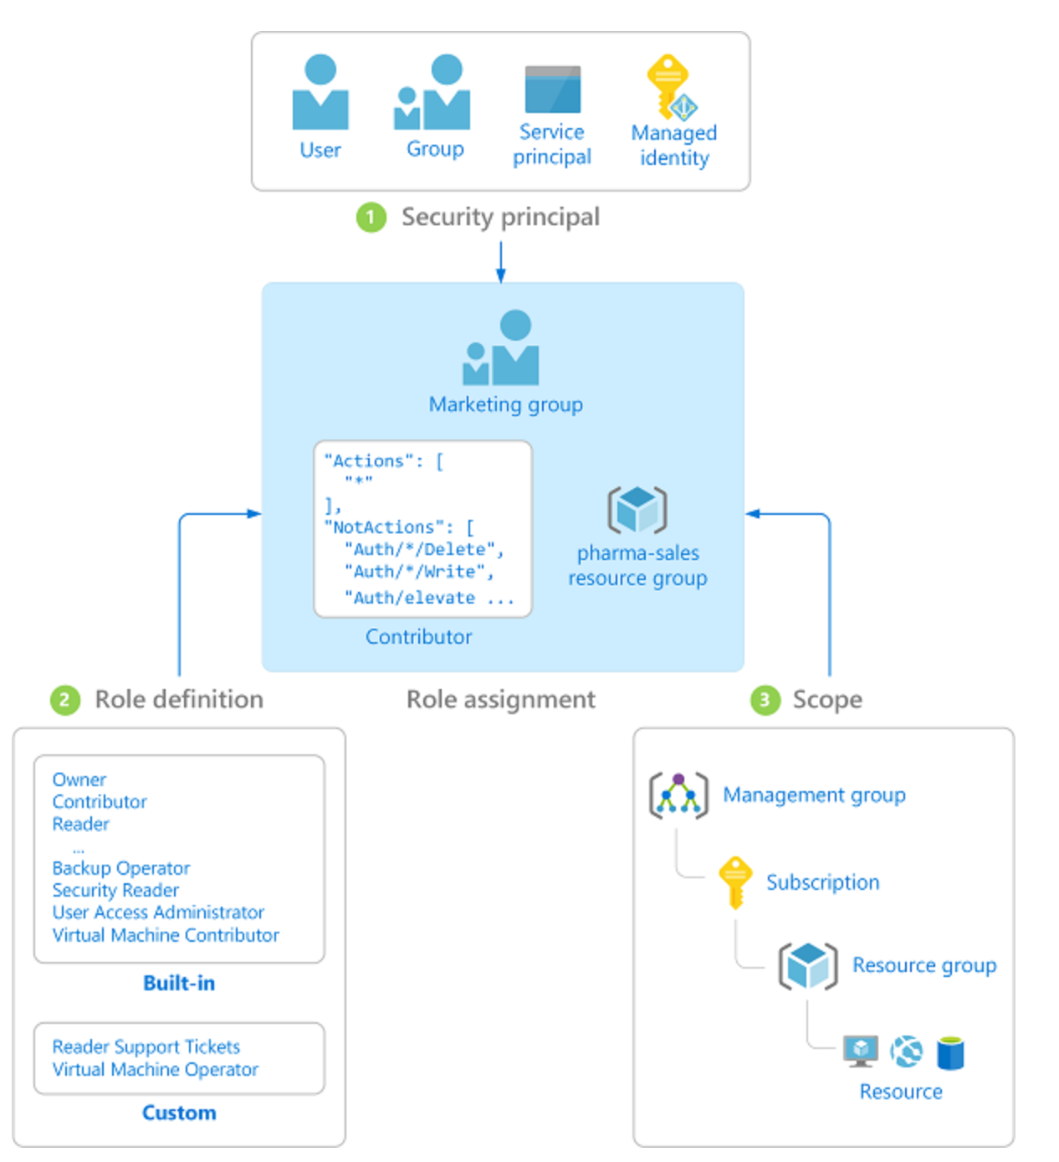
Azure RBAC (Role-Based Access Control)
Security Principal
User, group, service principal, managed identity
Role Definition
Collection of permissions (Actions, NotActions, DataActions, NotDataActions, AssignableScopes)
Scope
Set of resources the access applies to
Management Groups, Subscriptions, Resource Group, Resources
Role Assignment
Process of attaching role definition to a security principal

Slide 21
Azure RBAC - Design Recommendations
Before designing your Azure RBAC roles, establish a RACI matrix which tasks each team within the organization will be performing in Azure.
Follow the principal of least privilege and separation of duty when designing Azure RBAC roles.
Leverage Just-In-Time concepts for granting privileged roles which can include Azure AD Privileged Identity Management or a third-party PAM/PSM.
Start with built-in role definitions and customize as you better understand which tasks your teams will be performing in Azure.
Create RBAC Role definitions and assignments at the management group level whenever possible.

Slide 22
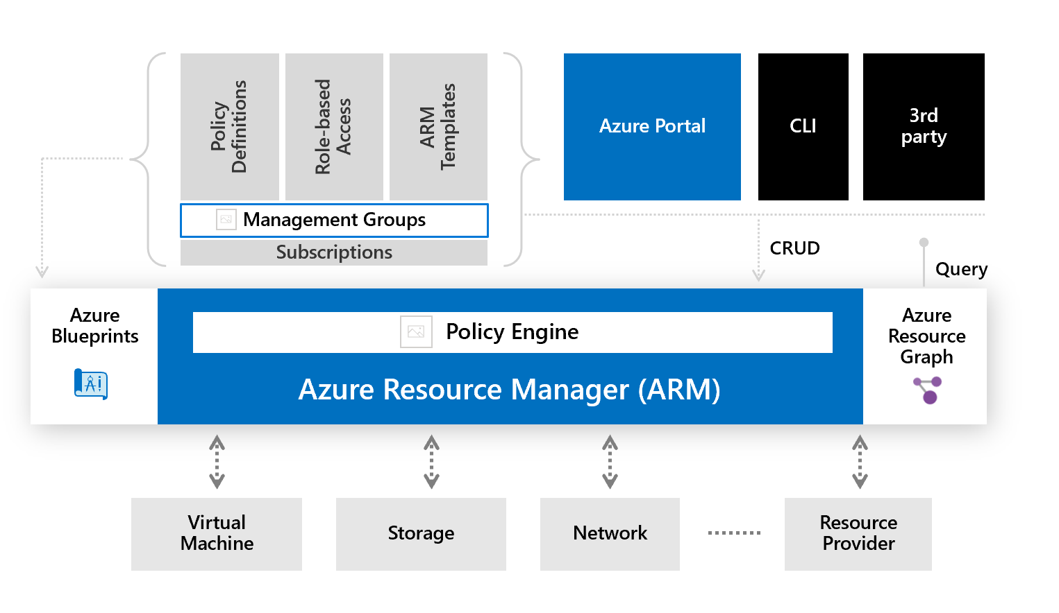
Azure Policy
Enforce organizational governance and compliance
Evaluates resource properties
Enforced as request flows through ARM API
Policies consist of a definition and an assignment
Policies can be consolidated into an initiative
Assign policy at the management group, subscription, resource group, and resource level

Slide 23
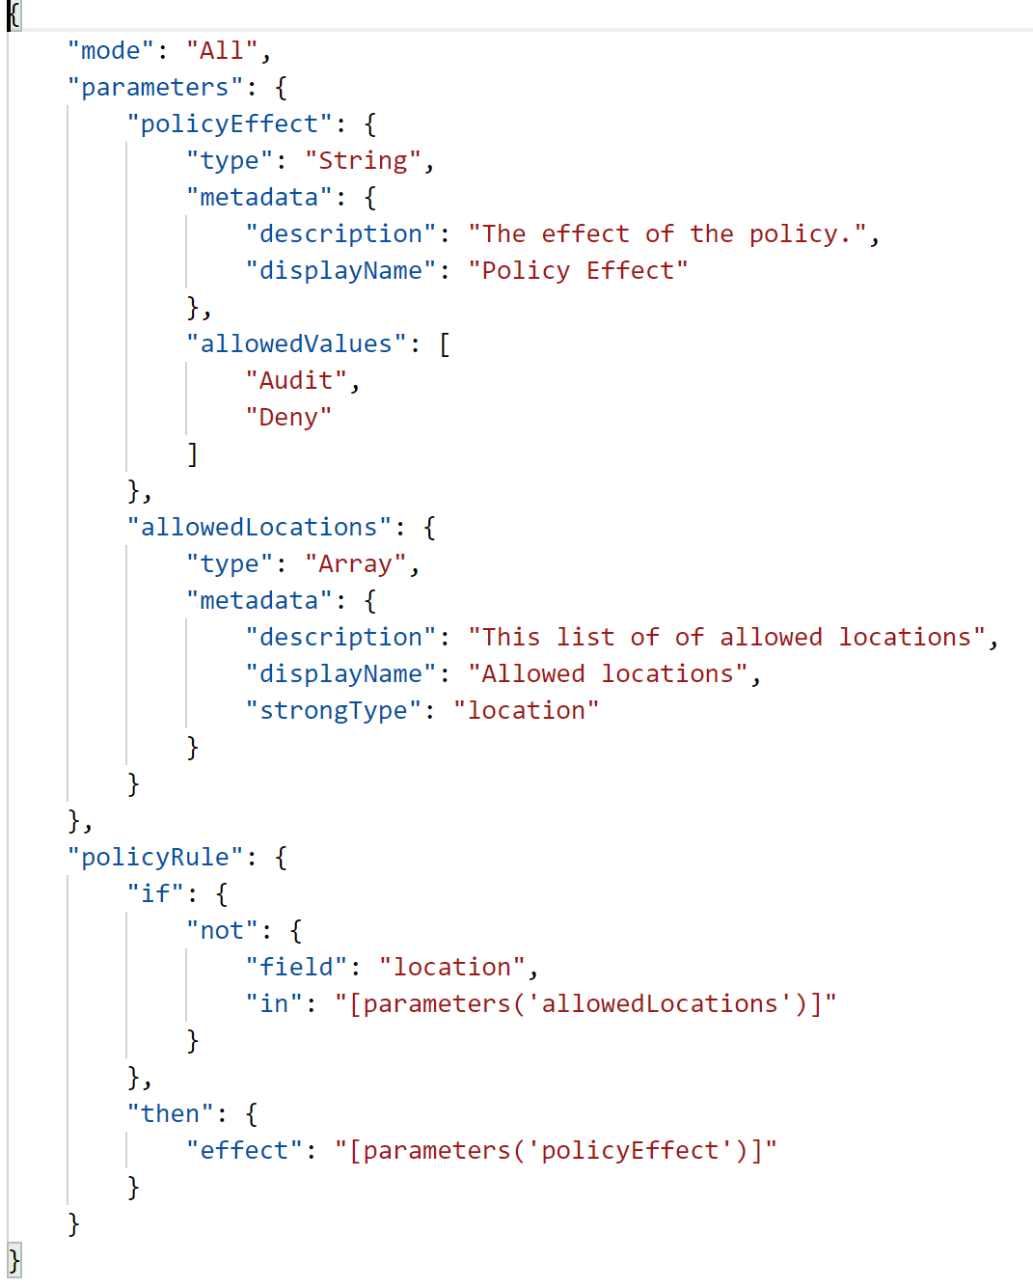
Azure Policy
JSON structure
Action such as Audit, Deny, Deploy if Not Exists, Modify
If-Then Logic
Incorporate parameters, built-in functions
Many built in policies for common compliance frameworks such as PCI, ISO 27001, CIS, NIST

Slide 24
Azure Policy - Design Recommendations
Identity the control frameworks the organization has adopted with and review the Azure Security Benchmark for control mappings.
Clone and customize built-in initiatives provided by Microsoft instead of directly applying the built-ins when enforcing policy (beyond just audit). This will allow you to control when new policies are added or removed to avoid impact to your workloads.
Apply policies and initiatives in audit only mode before enforcing policy to understand the current state and impact enforcement may create.

Slide 25
Azure Policy - Design Recommendations (continued)
Create and apply policy definitions and assignments at the management group level whenever possible to reduce operational overhead.
Create separate policy initiatives for production and non-production to allow for more agility in non-production environments.
Start with policies that enforce regional restrictions, logging, VM SKUs, and public IP usage.
Apply the Azure Security Benchmark built-in policy in audit mode in addition to your own organizational initiatives.

Slide 26
Useful Links
Azure Cloud Adoption Framework - https://docs.microsoft.com/en-us/azure/cloud-adoption-framework/
Cloud Journey - https://github.com/geeksintheweeds/cloud-journey
EA Portal Role Matrix - https://docs.microsoft.com/en-us/azure/cost-management-billing/manage/understand-ea-roles#usage-and-costs-access-by-role
Azure Policy GitHub - https://github.com/Azure/azure-policy
Azure Policy Community GitHub - https://github.com/Azure/Community-Policy

